Slide 1
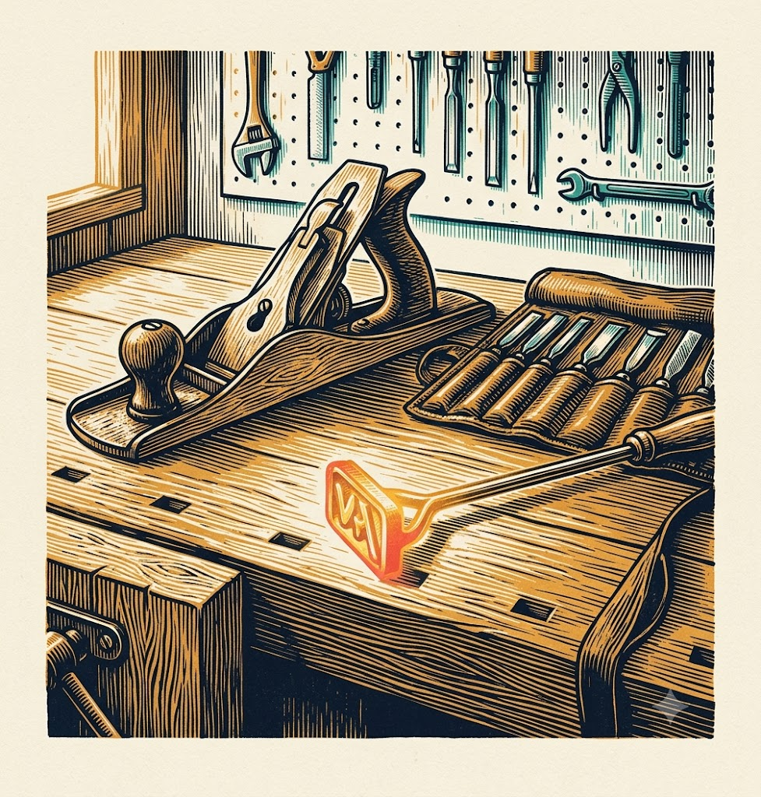
RIVIERADEV 2026 · PLATFORM ENGINEERING
From a prompt dumping ground
to a shared AI workbench
Prompt registry -
the open-source package manager for GenAI assets.
Prompt registry -
AI Primitive Hub-
How to start building and sharing enterprise knowledge
WALDEK HERKA · GUILLAUME BLANC

Slide 2









01 · AMADEUS
We are global, diverse, and big.
“I reckon all of you know our employer… in case you don’t, here are 15 seconds of evidence.”
GLOBAL
DIVERSE
BIG
190+ countries
150+ nationalities
20,000+ people
• Operations and customers worldwide
• Travel is global, so our software is too
• 60+ languages spoken internally
• Cross-domain travel tech expertise
• 400+ airlines served
• 2M+ hotel properties
TRAVEL DOMAINS WE COVER
Airlines
Airports
Hospitality
Travel sellers
Rail
Car rentals
Cruises
Payments

Slide 3



02 · LARGER CONTEXT
Where this comes from
Amadeus AI transformation
An org-wide push to put GenAI to work in engineering.
The AI-DLC initiative
An AI-augmented development lifecycle - primitives are part of it.
We started early
Before “skills” or “context engineering” were even concepts.
Expect “this was the best option at the time” moments - the ground kept moving.

Slide 4
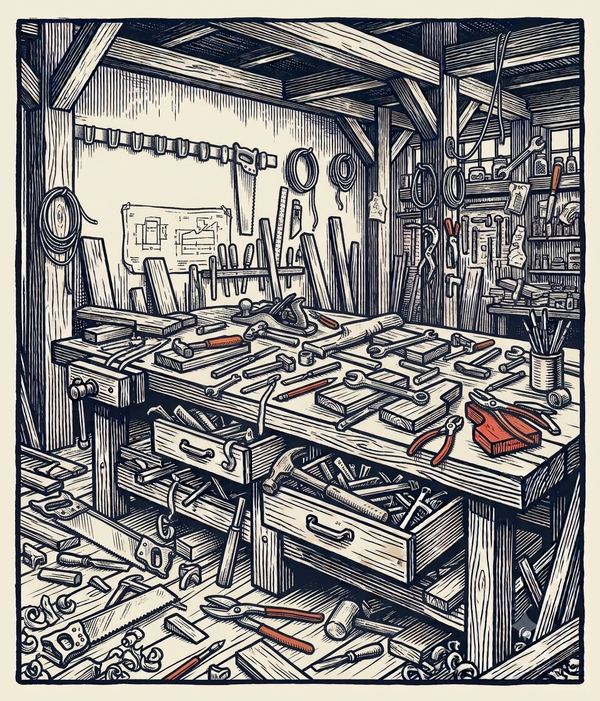




03 · WELCOME TO THE PROMPT LANDFILL
Painful enterprise AI starter pack
Assets are copied, not distributed
No idea what already exists
Improvements and standards never propagate
Teams keep solving the same problem independently
Shadow IT everywhere
No clear ownership
You can only govern what you can see.
Nobody knows who created, maintains, or validates an asset
“Prompt engineering” starts looking suspiciously like archaeology.

Slide 5
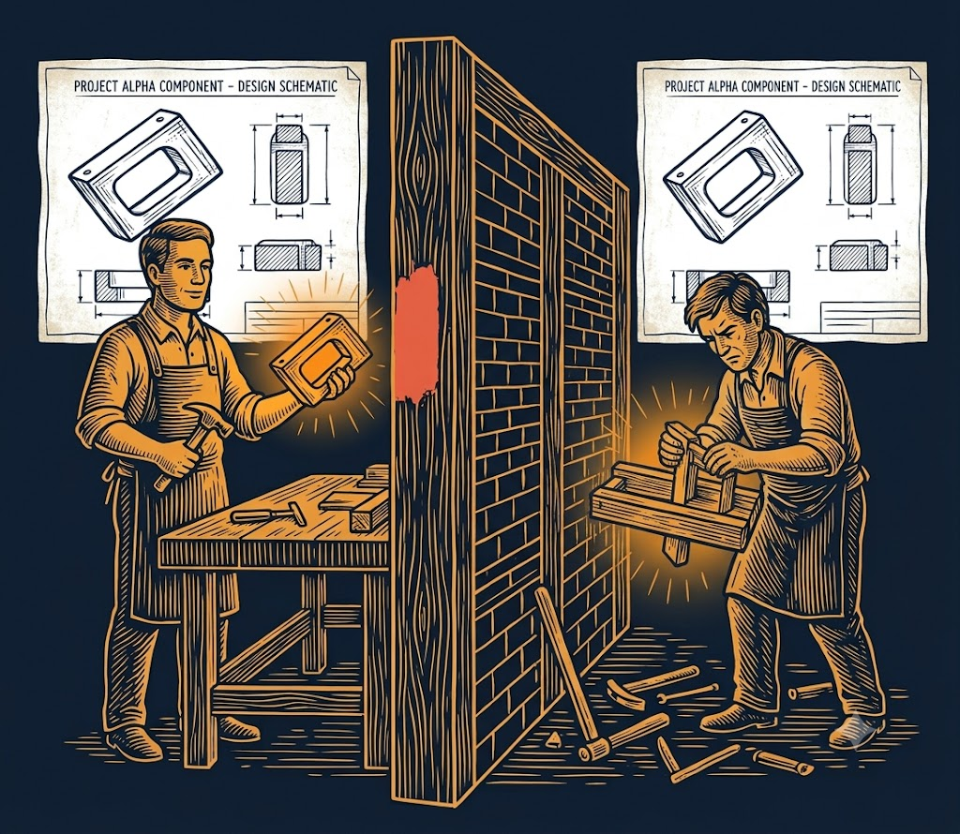
“
We never lacked good assets.
We just couldn't find - or share - them.
Somewhere, someone had already solved it. Nobody else knew it existed - or how to pass it on.

Slide 6
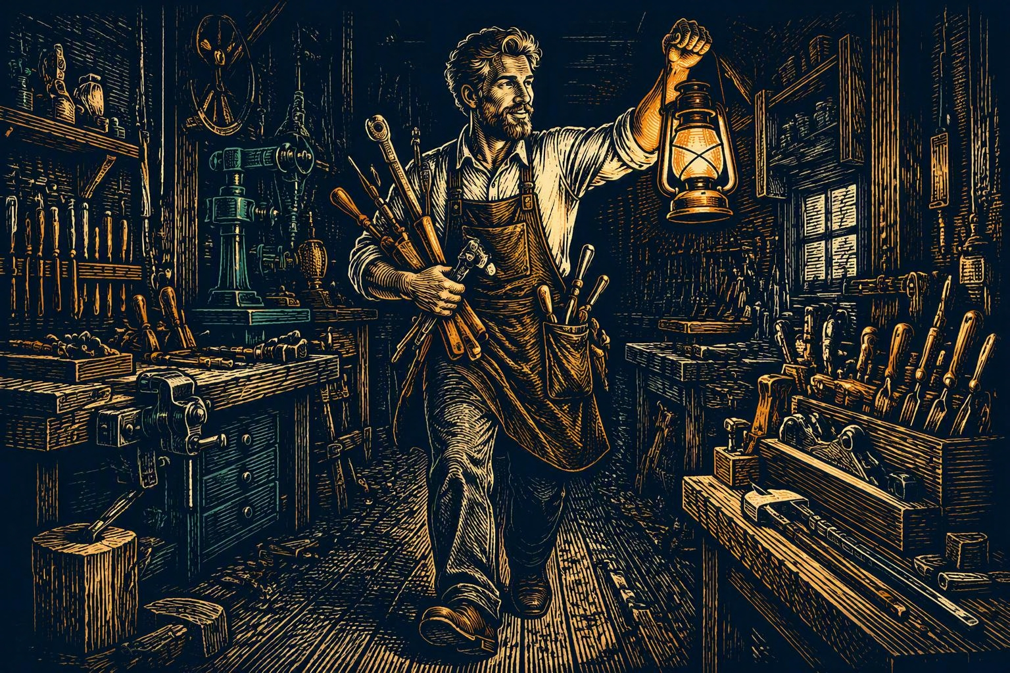
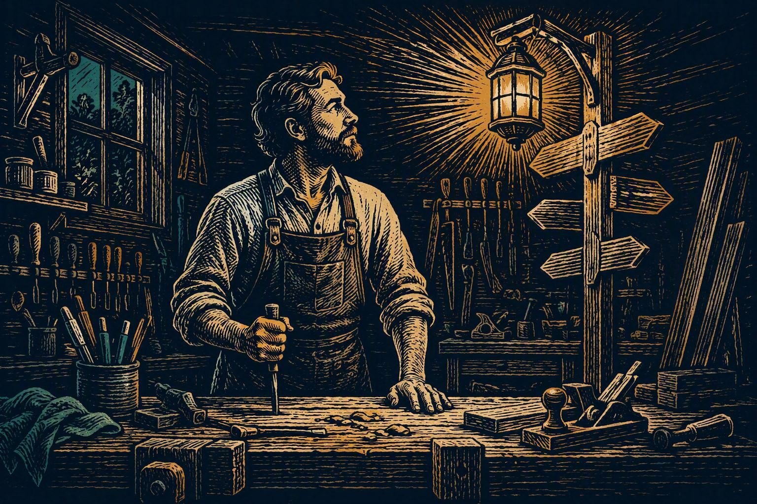
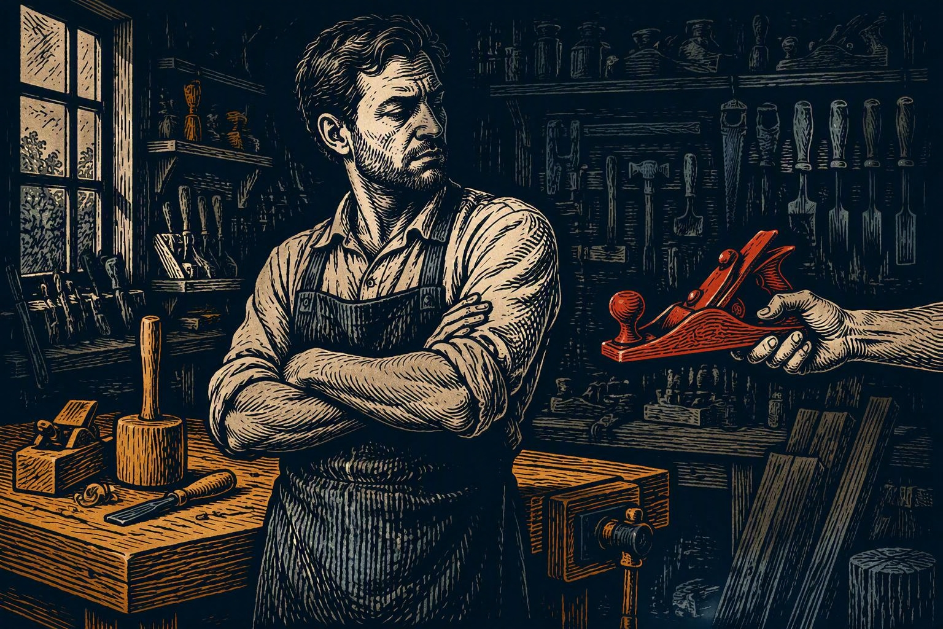
04 · WHO WERE WE TRYING TO HELP?
The AI adoption gap
THE ENTHUSIASTS
THE WILLING MIDDLE
THE SKEPTICS
Already flying ahead, aware of every tool.
Ready to move, waiting for guidance to do it right.
Some on principles; others not yet convinced it delivers value.

Slide 7



05 · THE REQUIREMENTS
Apply what software engineering taught us
Distribution
Discoverability
Federated contribution
Install, update and share assets consistently
Know what exists before rebuilding it
Let domain experts publish their knowledge directly
Ownership & provenance
Governance
Context Management
Know who created it, maintains it, and whether it can be trusted
Can be applied after onboarding
Install only what you need

Slide 8
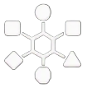
06 · THE PRODUCT MODEL
How the pieces fit together
Primitives
Prompts
Sources
Collections
exposed via
referenced
Instructions
Hub
Agents
Profiles
referenced
Skills
defined
Java Developer / QA / SRE
Developer in Team A / B
MCP Servers

Slide 9


07 · WHY “JUST USE THE MARKETPLACE” WASN'T ENOUGH
Marketplaces are not governance
Public marketplaces
Enterprise adoption
great for speed & experimentation
also needs trust & control
✓
Fast to publish and discover
+
Security, provenance, visibility
✓
Huge variety, low friction
+
Governance & update control
✓
Perfect for trying things out
+
Knowledge curation & contribution at scale
Marketplaces are fantastic - until your security model becomes “it had stars and the README had emojis.”

Slide 10
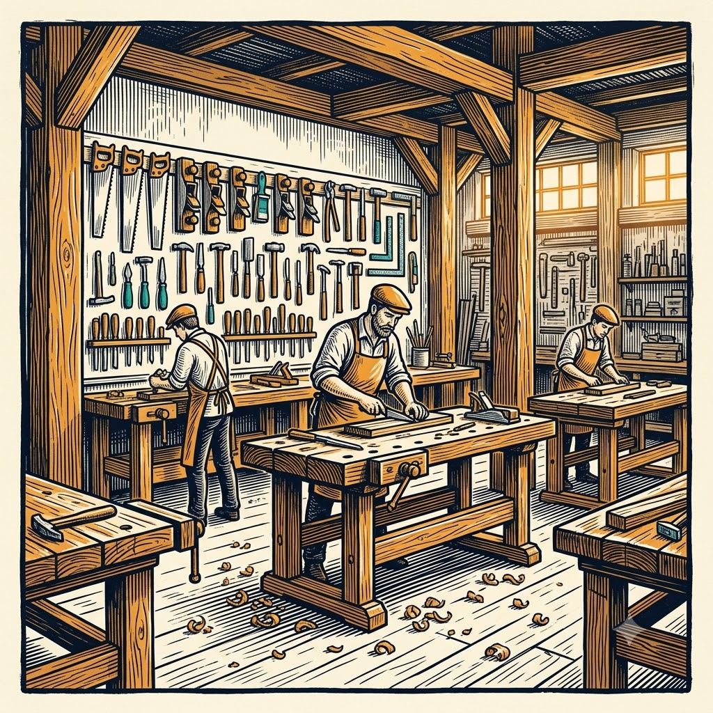
08 · THE DECISION
Not a tool.
A platform.
AI Primitives Hub discovers, installs, versions, organizes, and governs AI resources across tools and teams.
The VS Code extension is one of the interfaces. Not the one !
The platform mindset is the durable asset.

Slide 11
09 · LIVE DEMO
10 minutes on the workbench
LIVE
demo-flow
$ hub demo --flow
01
discover
02
install
03
publish

Slide 12
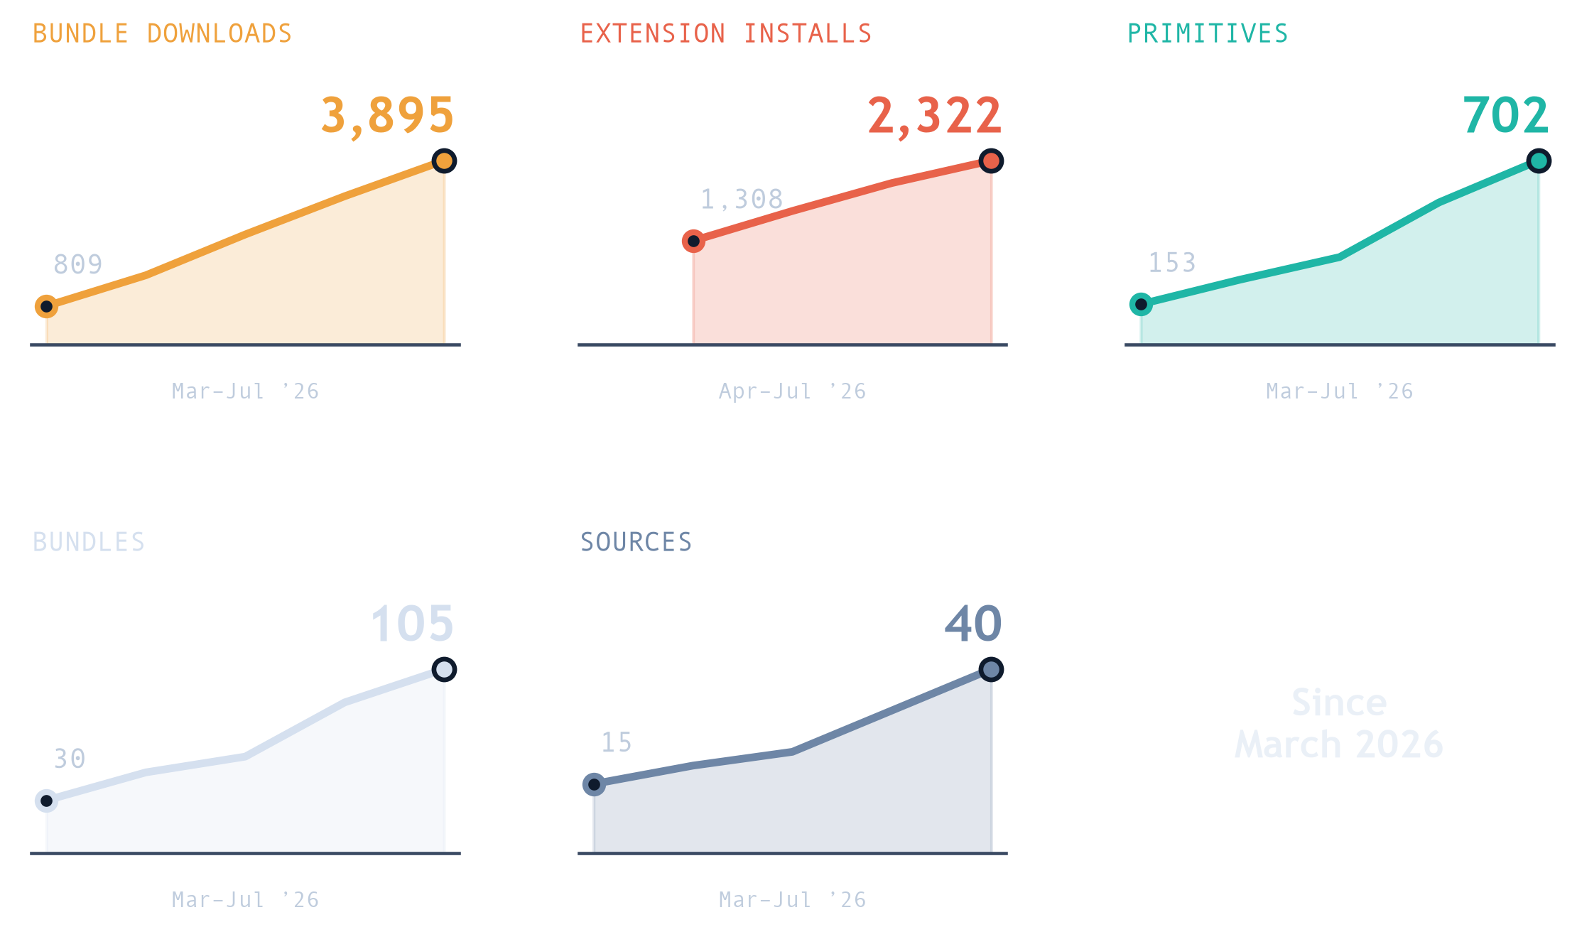
10 · WHAT ACTUALLY LANDED
What we've managed so far
Officially backed & adopted
From a best-effort side project to a supported platform teams build on.
Adoption & KPIs keep climbing
Downloads, installs and primitives climb every month - a slope, not a launch spike.
Company knowledge is converging
Scattered prompts becoming shared, discoverable assets.
Not complete - but pointed the right way.

Slide 13
11 · ROADMAP
From extension to AI engineering platform
Same assets. More tools. Stronger lifecycle.
NOW
NEXT
THEN
Shared catalog in the IDE
Same assets across tools
Lifecycle at scale
VS Code extension
>_
CLI
✓
Evaluation & regression
Sources
Cross-IDE
Observability
Profiles
Hooks & plugins
Renovate-style upgrades

Slide 14
12 · HONEST LEARNINGS
Lessons from building on moving sand
01
AI pace is brutal
04
Community buy-in arrives before backing
It is ok to be late. Be comfortable with that
Treat it as energy, not a governance bypass.
02
Expect unexpected especially with AI
05
Governance should enable speed
Design for conversion and adaptation.
Traffic lights allow faster and safer commute
03
Do not build a monster
06
Adopt proven solution or build with others
Start modular, invite feedback, stay understandable.
The need for enterprise level features is common.

Slide 15
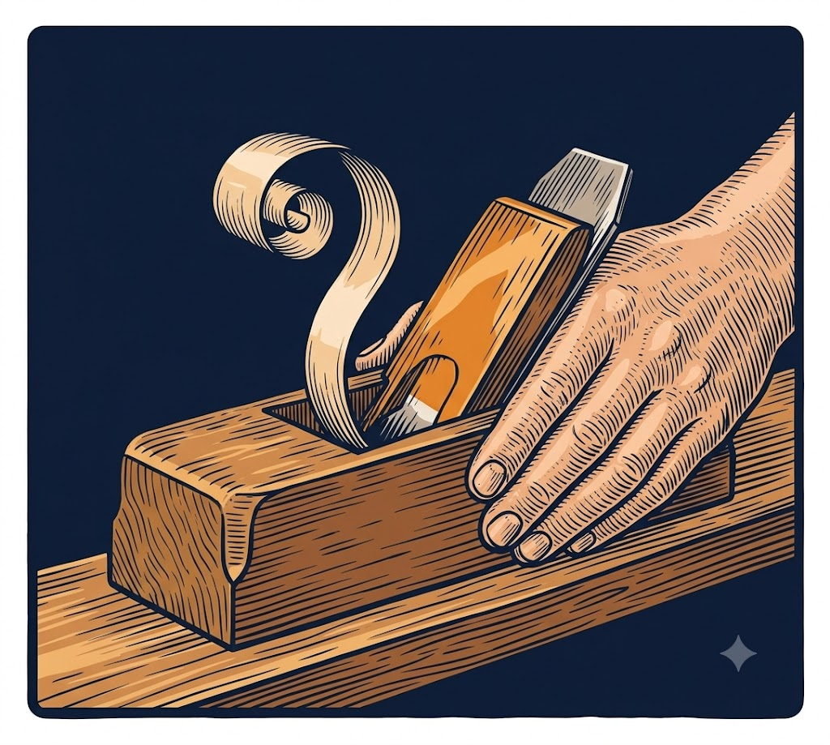
13 · CLOSING
AI primitives are the workbench.
The craftsman still guides the plane.
Don't bet on the trend - Focus even more on engineering best practices
Build knowledge as a community - First share it and then curate it
We remain in charge of the direction, define the standards, and remain accountable for the outcomes.

Slide 16


14 · Q&A
https://github.com/AmadeusITGroup/ai-primitives-hub
Slide deck
Open Feedback link
THANK YOU
Questions?
LET'S CONNECT
Let's talk platforms, monsters, and the next dramatic podcast episode.
in
linkedin.com/in/gblanc
in
linkedin.com/in/waldek-herka
AI Primitives Hub · RivieraDev 2026

